Slide 1

Secure Authentication Protocol for IoBT
Team Number: CB1
AM.EN.U4CSE20222 - Devu Pawan Ashutosh
AM.EN.U4CSE20163 - Shoaib Akhtar
AM.EN.U4CSE20232 - Hardik Kumar Singh
AM.EN.U4CSE20225 - Yeshwanth Reddy
Guide : Dr Nimmy K
Amrita School of Computing | Amrita Vishwa Vidyapeetham | Amritapuri

Slide 2
Introduction
Current authentication methods within the IoBT context often prove inadequate in ensuring battlefield security.
Inadequacy of traditional methods: Passwords and tokens present several vulnerabilities in the battlefield:
1) Risk of loss or compromise
2) Operational delays
3) Need for instant, resilient authentication
Notes:
Imagine being on the battlefield with adrenaline levels shooting up limits in a critical situation and you have to remember a long 14 character password that you heard once before stepping on to the field. You are all sweaty and pumped up not feeling what the weather outside is and the biometric device refuses to authenticate because your fingers might be sweaty, bleeding or even wounded. Taking that situation into consideration we have developed our project that implements a secure authentication protocol for Iobt(internet of battlefield things). An battlefield environment is an environment where the conditions are very harsh, difficult to adapt to and is one you would like to get out of as soon as possible, unless you have objectives yet to be completed. The current authentication methods within the IoBT context often prove inadequate in ensuring battlefield security. The various issues with traditional methods are: risk of data loss or compromise, i.e a high risk of impersonation attack or data getting into enemy’s hand, operational delays are also an issue in as to the request and response should be quick improving soldier security. Also, the suthentication process should be quick and robust so that the soldier would not have to waste time verifying that he is from your side and could acces confidential or critical data with ease.

Slide 3
Introduction
Enhanced Data Security
Increased Operational Efficiency
Improved Soldier Safety
Transferable Application

Slide 4
Motivation
Real-time tactical advantage: Secure, rapid authentication enables soldiers to obtain critical battlefield data in the heat of the moment, facilitating informed decision-making.
Protection of sensitive data: Robust authentication mechanisms prevent adversaries from compromising battlefield intelligence, safeguarding strategic information assets.
Ensuring life-saving efficiency: Instantaneous authentication empowers medics to access vital medical records, leading to swift and potentially life-saving treatment in the field.
Prevention of impersonation: The system safeguards the IoBT against malicious actors who may attempt to impersonate authorized personnel, bolstering operational security.

Slide 5
Background Study/Related Work
Title & year | Problem | Contributions | Limitations | Open problems/Future work
A Secure, Lightweight, and Anonymous User Authentication Protocol for IoT Environments Date - August 2021 | Existing authentication schemes in IoT environments often suffer from security vulnerabilities Many of these schemes require significant computational resources, making them unsuitable for resource-constrained IoT devices. Lack of focus on user anonymity and untraceability, crucial for privacy in IoT contexts. | The protocol primarily relies on hash functions and XOR operations. These are efficient compared to heavier cryptographic operations, making the protocol suitable for low-power IoT devices. Three-Factor Authentication: The protocol incorporates three factors: Password Smart Card Biometric Data | Resilience to Physical Attacks: The paper focuses heavily on withstanding network-based attacks. However, IoT devices can be vulnerable to physical attacks Large-scale scenarios with many concurrent users could introduce potential bottlenecks not evident in theoretical analysis. | Real-World Biometric Integration Evaluating the scalability of the protocol under heavy load or in scenarios with a large number of users and devices. Analyzing the protocol's vulnerability to physical attacks, such as smart card cloning or side-channel attacks on devices.

Slide 6
Title & year | Problem | Contributions | Limitations | Open problems/Future work
A Novel Secure Authentication Protocol for IoT and Cloud Servers Date - Mar 2022 | Existing authentication methods for IoT environments are often susceptible to attacks like impersonation, man-in-the-middle attacks, offline password guessing, etc. Ensuring robust security in IoT can introduce computational burdens, which might be unsuitable for resource-constrained IoT devices. | ECC-Based Protocol: They propose a new authentication scheme that leverages Elliptic Curve Cryptography (ECC). ECC offers strong security with smaller key sizes, potentially making it suitable for IoT. They claim that their protocol has improved computational efficiency / reduced communication overhead compared to existing alternatives. | Theoretical Focus: The emphasis is likely on theoretical analysis and potential security advantages without extensive real-world implementation and testing. Hardware Constraints: ECC, while relatively efficient, still may introduce overhead for extremely low-powered IoT devices. | Analyze the protocol's vulnerability to side-channel attacks on IoT devices. Check potential countermeasures like masking techniques or randomization to make side-channel analysis more difficult. Investigate integration with post-quantum cryptography algorithms as they mature

Slide 7
Title & year | Problem | Contributions | Limitations | Open problems/Future work
IoT Based Military Assistance and Surveillance Year - 2018 | Soldiers on the battlefield lack a system to easily gather data from their surroundings, communicate with teammates and base stations, and monitor their health. | Proposed a wearable military assistance and surveillance system (MASS) concept: The authors propose a novel concept for a wearable system called MASS that can address the limitations of current military communication and monitoring systems. Designed a system to monitor soldier's health and surroundings: The MASS system incorporates various sensors to monitor a soldier's health, including heart rate, and surrounding conditions such as temperature, humidity, air quality, and presence of harmful gases. Incorporated soldier messaging capabilities | Challenges with programming and hardware integration: Limitations with using analog pins on the Node MCU microcontroller, which necessitated using an Arduino Nano in parallel to address these limitations. They faced challenges with the DHT11 sensor not functioning properly when used in conjunction with other sensors due to software interrupt conflicts. The solution involved implementing a daisy chain methodology to manage the sensors effectively. | The authors acknowledge that the current prototype of the MASS system is relatively bulky due to the various components and sensors involved Future work could focus on designing a more compact and ergonomic enclosure that would be comfortable for soldiers to wear during missions

Slide 8
Title & year | Problem | Contributions | Limitations | Open problems/Future work
Lightweight and Privacy-Preserving Remote User Authentication for Smart Homes Published in: IEEE Access ( Volume: 10 ) Date of Publication: 21 December 2021 | Existing user authentication protocols are not resilient to smart home attacks and incur additional computational overhead. | The protocol is resilient to smartphone capture attacks and phishing attacks due to the use of Photo Response Non-Uniformity (PRNU). It is also lightweight and suitable for deployment on resource-constrained IoT devices. Geometric secret sharing is used for establishing mutual authentication among the participating entities. The comparison with existing schemes reveals that their scheme incurs a 20% reduction in communication overhead on smart devices. | PRNU Reliance: The protocol heavily depends on the Photo Response Non-Uniformity (PRNU) feature of smartphone cameras. While promising, potential inconsistencies in image sensor noise or variability caused by image processing techniques could affect the reliability of this feature. Single Device Assumption: The protocol seems to assume a scenario where the user interacts primarily with a single smart home device. More complex multi-device authentication flows might need additional considerations. Physical Attacks: While the paper addresses remote attacks, it does not explicitly discuss the protocol's robustness against physical side-channel attacks on smart devices, if an attacker gains access to the device. Scalability: The computational overhead for large-scale, many-user smart home environments is not thoroughly evaluated. | Resistance to Physical Attacks: Exploring defenses or countermeasures against possible side-channel attacks on physical devices in the system. Integration with Other Technologies: Investigating how the proposed protocol could be integrated with other emerging technologies like blockchain or advanced biometrics to further enhance security.

Slide 9
Title & year | Problem | Contributions | Limitations | Open problems/Future work
Fuzzy Extractors from Fingerprints Year - 2013 | Noisy Biometric Data Fingerprint possess inherent intra-class variability. Variations due to sensor quality, pressure, and environmental factors prevent direct use as cryptographic keys. Inefficient Fuzzy Extractors: Existing fuzzy extractor constructions at the time often exhibited high computational overhead, making their deployment in user authentication systems impractical. | The authors likely focus on minimizing the size of the "helper data" generated by the fuzzy extractor. This reduces storage overhead. Key Indistinguishability: An adversary cannot learn substantial information about the secret key derived from the fingerprint, even with access to the helper data. They achieved constant computational cost during the identification phase. This is crucial for real-time authentication scenarios, especially on resource-constrained devices. | The fuzzy extractor's performance is likely tied to the type of fingerprint sensor used. Optimizations for one sensor might not generalize perfectly to sensors with significantly different characteristics. Theoretical security analysis often focuses on the core fuzzy extractor algorithms. Practical implementations might introduce side-channel vulnerabilities (e.g., timing attacks) if not carefully secured. | Cross-Sensor Generalization: Exploring techniques to make the fuzzy extractor less sensitive to specific sensor types. Template Update Mechanisms: Research into secure and efficient methods to update stored fingerprint templates or helper data to accommodate long-term biometric changes would be valuable.

Slide 10
Persisting Challenges
Challenges identified
Inherent Fingerprint Variability: Fingerprints change slightly with each scan due to pressure and skin conditions, making exact matching difficult.
Security Risks of Storing Raw Fingerprints: Storing raw fingerprint images risks privacy breaches and identity theft if the database is compromised.
Communication Vulnerabilities: Data transmission between the device and server can be intercepted or tampered with, leading to unauthorized access.
Hardware Limitations: Fingerprint sensor quality, environmental factors, and wear and tear affect accuracy and reliability.
Geometric Secret Sharing Complexity: Implementing geometric secret sharing increases complexity, storage, and communication overhead in the system.

Slide 11
Persisting Challenges
Challenges addressed
Inherent Fingerprint Variability: Utilize a fuzzy extractor to extract a stable cryptographic key from variable fingerprint readings, ensuring reliable authentication.
Security Risks of Storing Raw Fingerprints: Employ a fuzzy extractor to derive a cryptographic key from the fingerprint and only transmit this key to the gateway, avoiding the storage of raw fingerprint images.
Communication Vulnerabilities: Implement a combination of encryption protocols and geometric secret sharing for mutual authentication, along with socket programming for secure data transmission.
Hardware Limitations: Utilize Raspberry Pi for its lightweight and compact nature, ensuring efficient processing and minimal resource consumption.
Geometric Secret Sharing Complexity: Optimize the implementation of geometric secret sharing to minimize computational and communication overhead while maintaining security. Employ a centralized storage solution that is optimized for efficiency and security.

Slide 12
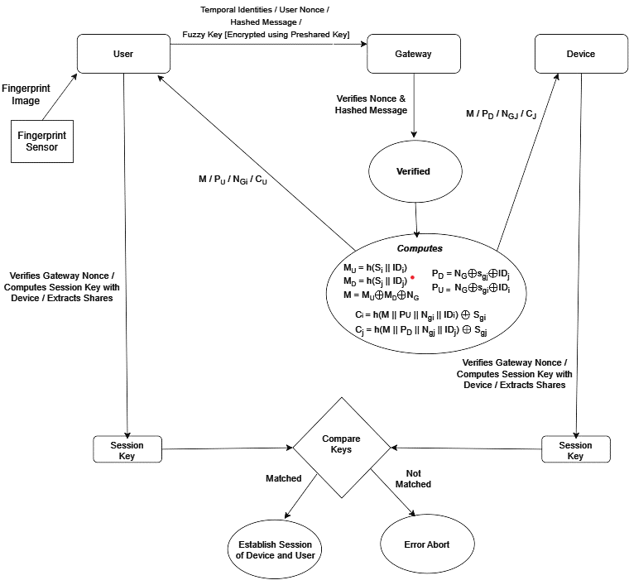
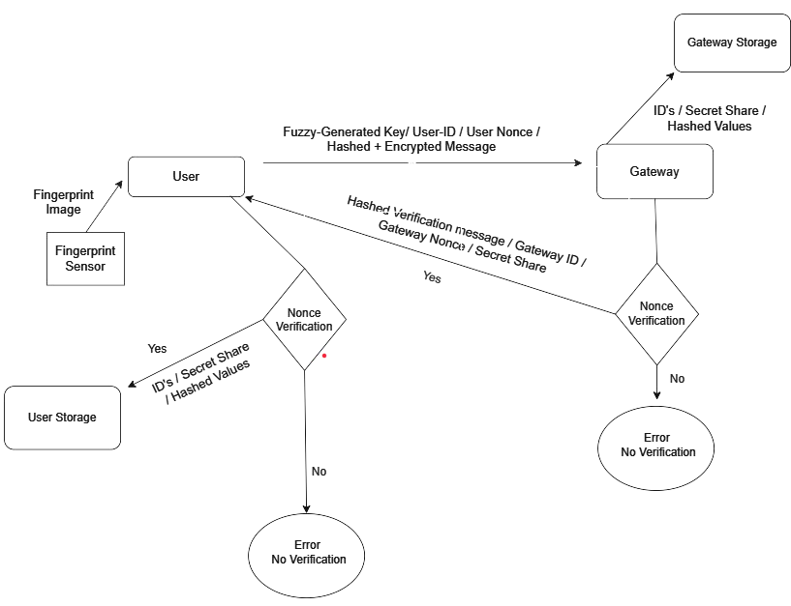
High Level Design
Registration Phase Authentication Phase

Slide 13
Project Contributions
Key Contributions
Adaptive Biometric Authentication for Demanding Environments: This solution introduces a robust yet user-friendly biometric authentication system tailored for challenging environments like battlefields. By integrating fuzzy extractors with fingerprint recognition, it accommodates the natural variations in biometric data that can occur in such settings, ensuring reliable authentication even under less-than-ideal conditions.
Security through Mutual Authentication: The implementation of geometric secret sharing establishes a heightened level of security through mutual authentication. This means both the user's device and the central server verify each other's authenticity, mitigating the risk of unauthorized access, man-in-the-middle attacks, and server impersonation.

Slide 14
Project Contributions
What are the objectives?
Primary Objective:
Design and implement a robust, user-friendly biometric authentication protocol that leverages fingerprint recognition, specifically tailored for the challenging conditions and high-security requirements of battlefield environments.
Secondary Objectives:
Usability and Resilience: Ensure the system is easy to use and tolerant of minor variations in fingerprint scans that may occur in battlefield conditions.
Data Protection: Implement strong security measures to safeguard biometric data, preventing the reconstruction of fingerprint templates from stored information.
Impersonation Prevention: Mitigate the risk of unauthorized entities impersonating users or sensors within the battlefield network, maintaining the integrity of the authentication process.

Slide 15
Project Contributions
What are the outcomes?
Enhanced IoBT Security: The protocol contributes to stronger user identification mechanisms, making unauthorized access to IoBT systems more difficult.
Improved Soldier Experience: The tolerance for minor fingerprint variations aims to reduce frustration from repeated scan failures.
Privacy Considerations: Storing helper data instead of raw fingerprints, along with robust security measures, addresses potential privacy concerns associated with biometric authentication.
State the assumptions if any
Fingerprint Scanner Reliability: We assume a reasonable level of accuracy in the fingerprint sensors used by client devices.
Secure Communication Channels: The system assumes the use and correct implementation of TLS or similar protocols to protect data in transit.
Moderate Computational Resources: The protocol is designed with resource-constrained devices in mind but assumes some computational capability on the client and server side.

Slide 16
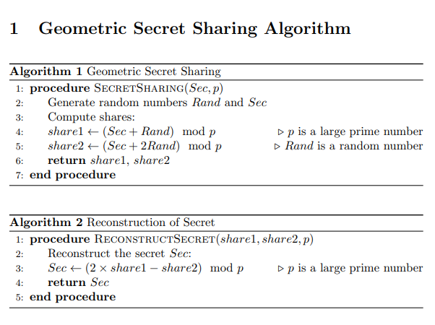
Algorithms

Slide 17
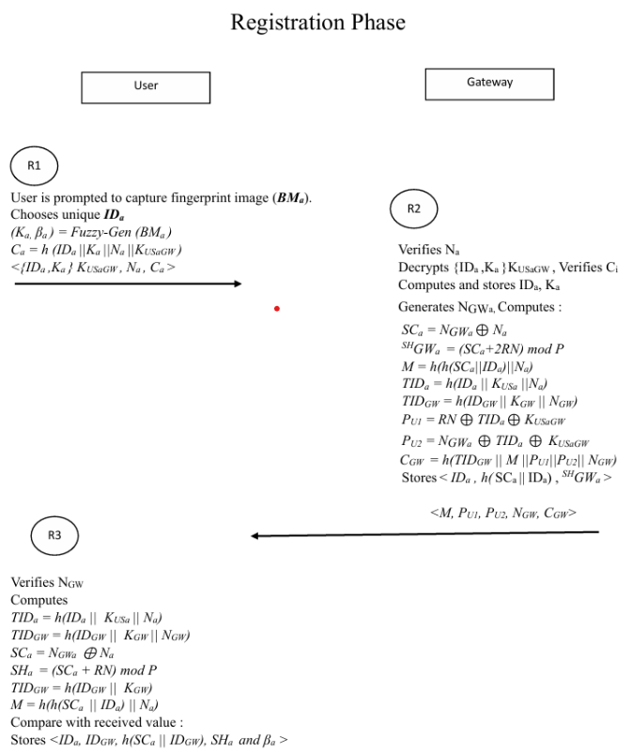
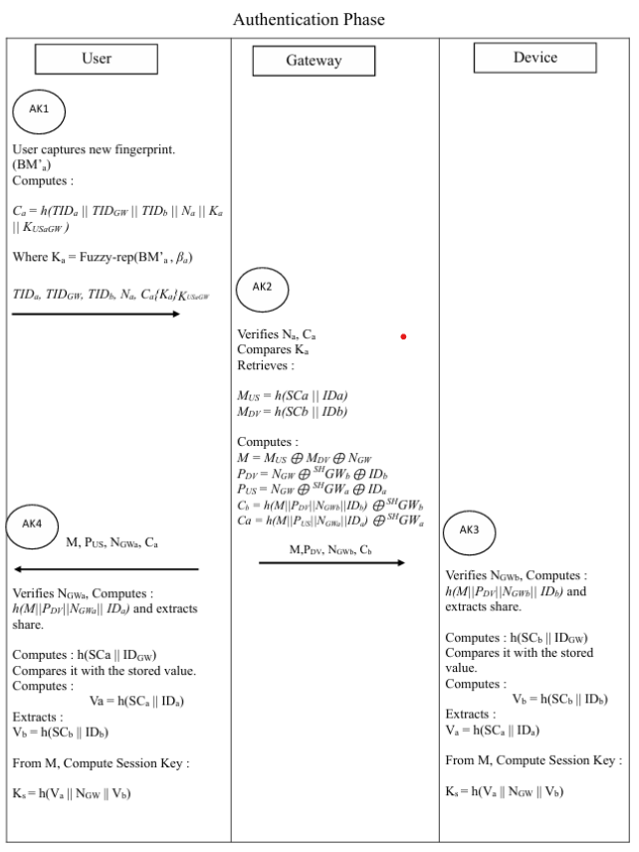

Slide 18
Security Analysis using AVISPA
AVISPA stands for Automated Validation of Internet Security
Protocols and Applications.
One of the most popular and commonly used tools for performing formal verification of the security protocols
Uses four primary back ends for analyzing the security of protocols
On-the-fly model checker (OFMC)
Constraint-logic-based attack searcher (CL-AtSe)
SAT-based model checker (SATMC)
Tree automata based on automatic approximations for the analysis
of security protocols (TA4SP)
Notes:
OFMC checks the security of a system in real-time, as actions occur. It's like having a security guard constantly patrolling to ensure nothing suspicious is happening.
CL-AtSe uses logic and constraints to search for patterns that might indicate an attack. It's like a detective analyzing clues to uncover suspicious behavior.
SATMC checks the satisfiability of logical formulas representing system properties. It determines if it's possible for certain events to occur. It's like asking, "Can this scenario really happen?“
TA4SP uses automatic approximations to analyze security protocols. It's like creating a detailed map of the protocols to understand how they work and where vulnerabilities might exist.

Slide 19
Security Analysis - Anonymity
Preserves privacy by hiding the identities of the communicating
entities from eavesdroppers
Temporal identities as TDi = h(IDi||KUi ||Ni), TDG = h(IDi||KG||NG) and TDj = h(IDj)||Kj ||Nj)
Temporal identities vary for each session.

Slide 20
Security Analysis using AVISPA – Key Freshness
Generated session key is fresh and is not used in any previous run of the protocol
Ks = h(h(Si||IDi)||NG||h(Sj ||IDj))
Freshness of the key is ensured by the presence of nonce generated by G

Slide 21
Security Analysis using AVISPA – Fake Gateway Attack
Adversary adds a fake gateway to steal the credentials, such as stored keys, or hijacks communication between the user and the smart device.
The fake gateway won’t be able to decrypt the message < TDi, TDG, TDj , h(I),Ni,Ci, {I}KUiG > as it doesn’t own the key KUiG
Fake gateway won’t be able to compute the message < M, PU,NGi ,Ci >
Mutual authentication prevents fake gateway attacks

Slide 22
Security Analysis - Resilience to Replay Attacks
Adversary replays the message < TDi, TDG, TDj , h(I),Ni,Ci, {I}KUiG > with a modified Ni
G will abort the protocol as Ci won’t match with the received value.

Slide 23
Security Analysis - Resilience to Fingerprint Forgery Attacks
A generates a forged key using the fuzzy-extractor extracted from publicly available images of the user Ui
A does not possess the shared key KUiG, public keys of Ui and G, the share si and h(Si||IDG)

Slide 24
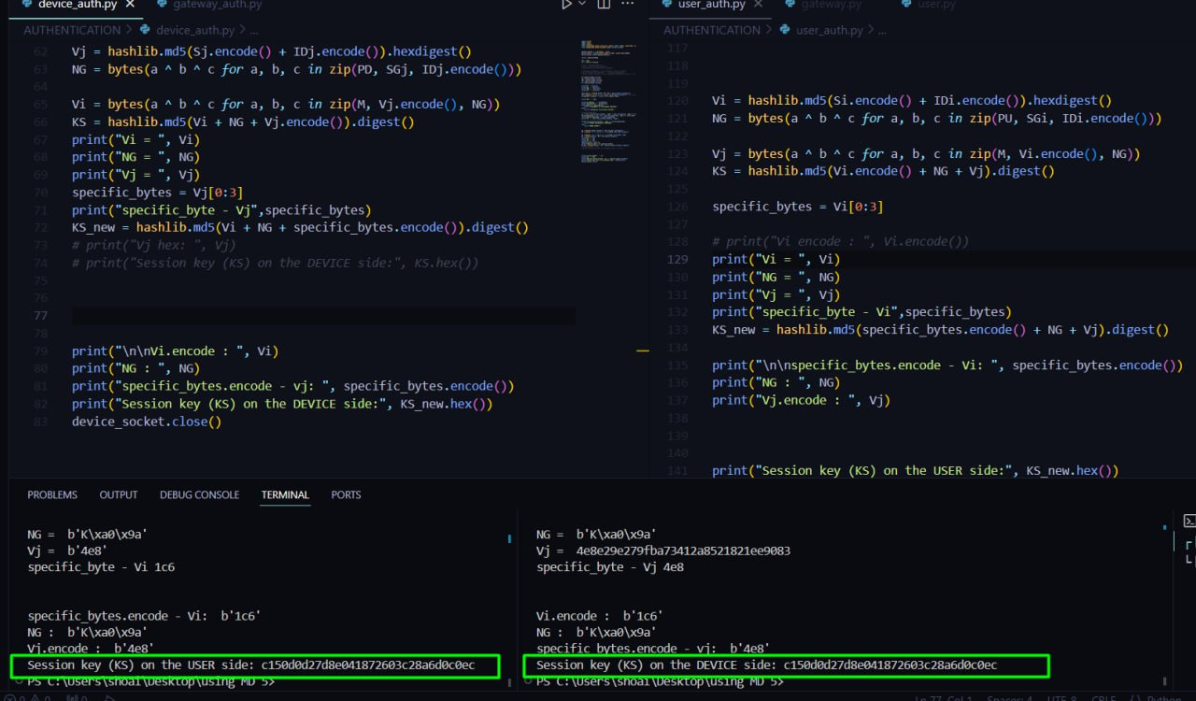
Current status
The Session Key has been generated on both device and user and is coming equal given that the same key is being provided to the protocol

Slide 25
References
M. Wazid, A. K. Das, N. Kumar, and J. J. Rodrigues, "Lightweight and privacy-preserving remote user authentication for smart homes," in IEEE Access, vol. 10, pp. 138512-138523, 2021, doi: 10.1109/ACCESS.2021.3138664.
N. Li, F. Guo, Y. Mu, W. Susilo and S. Nepal, "Fuzzy Extractors for Biometric Identification," 2017 IEEE 37th International Conference on Distributed Computing Systems (ICDCS), Atlanta, GA, USA, 2017, pp. 667-677, doi: 10.1109/ICDCS.2017.107. keywords: {Authentication;Data mining;Protocols;Servers;Biometrics (access control);Noise measurement}
Iqbal, Ummer & Tandon, Aditya & Gupta, Sonali & Yadav, Arvind & Neware, Rahul & Gelana, Fraol. (2022). A Novel Secure Authentication Protocol for IoT and Cloud Servers. Wireless Communications and Mobile Computing. 2022. 1-17. 10.1155/2022/7707543.
Raja, P., Bagwari, S., Raja, P., & Bagwari, S. (2018, April). IoT Based Military Assistance and Surveillance [Paper presentation]. 2018 International Conference on Intelligent Circuits and Systems (ICICS), 76-81.
K. Nimmy, S. Sankaran, K. Achuthan and P. Calyam, "Lightweight and Privacy-Preserving Remote User Authentication for Smart Homes," in IEEE Access, vol. 10, pp. 176-190, 2022, doi: 10.1109/ACCESS.2021.3137175. keywords: {Authentication;Protocols;Smart homes;Security;Cryptography;Logic gates;Passwords;Resilience;Internet of Things;Authentication protocol;Internet of Things;protocol resiliency;geometric secret sharing;smart home;PRNU},

Slide 26
Thank You

